Slide 1
Sensors Technology
BECE409E

Slide 2
Sensors Technology
BECE409E
Module 2: RLC and Self Generating Sensors
Resistive Sensors – Strain Gauges, Resistance Temperature Detectors, Thermistors, Light dependent resistors, Self and Mutual Inductive Transducers, LVDT, Capacitive Transducers, Variable Distance, Variable Area, Variable Dielectric Type Capacitive Sensors. Self-Generating Sensors – Thermoelectric Sensors, Piezoelectric Sensors, Pyroelectric sensors, Photovoltaic sensors, Electrochemical Sensors.

Slide 3
Resistive Sensors

Slide 4
Resistive Sensors
Resistive sensors are common because many physical variables affect a change in resistance.
R = f(Δl) stress
R = f(Δd) displacement
R = f(Δθ) angle
R = f(T) temperature
R = f(Hu) humidity R = f(N) gas conct
R = f(H) magnetic field
R = f(f) photon light

Slide 5


Resistive Position Sensors
Displacement
Electrical signal

Slide 6
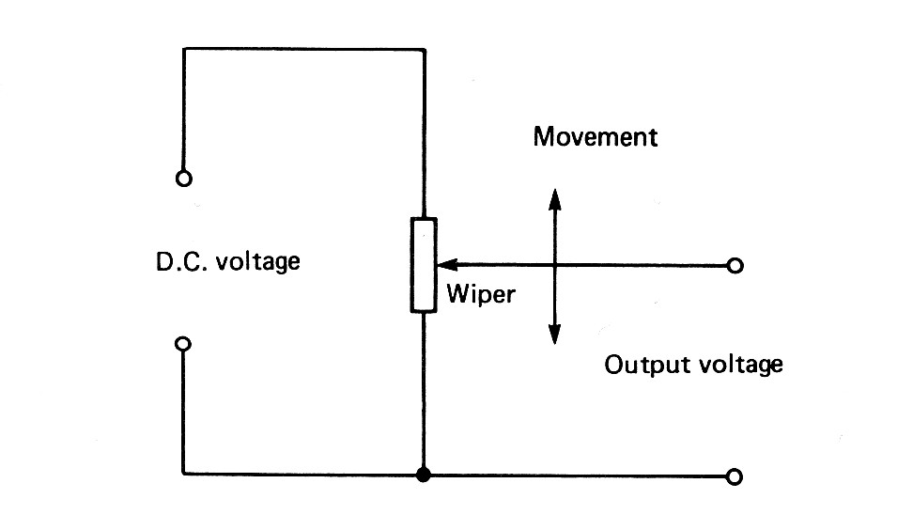
Position Sensors
A Potentiometer may be used to measure position or movement.
Electrical contacts age and can become unreliable.
4

Slide 7
Potentiometer Sensors
The simplest sensor is the Potentiometer
R = ρL/A where L is the length from the end of the resistance to the wiper contact.
In 1871 G. Little patented the variable resistor.
In 1907 H. P. MacLagan patented the rotary potentiometer.
In 1945 A.O. Beckman patented the multiturn precision potentiometer.

Slide 8
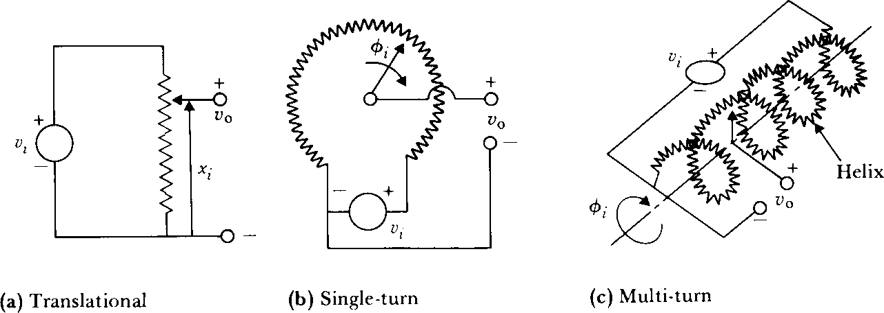
Resistive sensors - Potentiometers
Measure linear and angular position
Resolution a function of the wire construction
Measure velocity and acceleration
2 to 500mm
From 10º to more than 50º

Slide 9
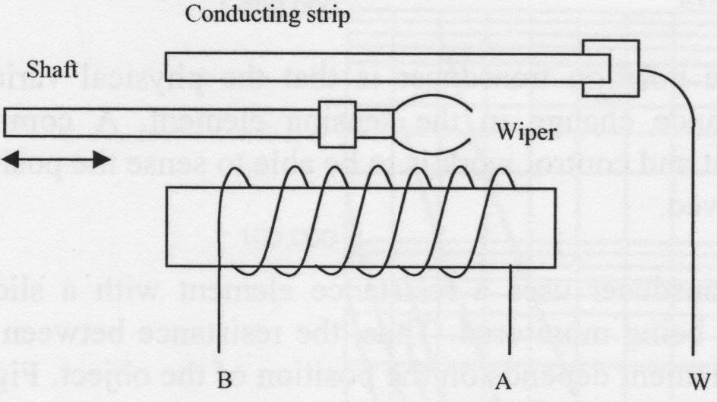
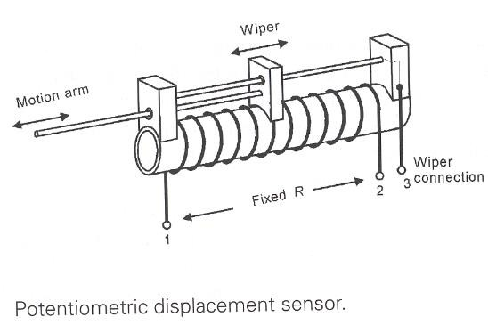
Potentiometers

Slide 10
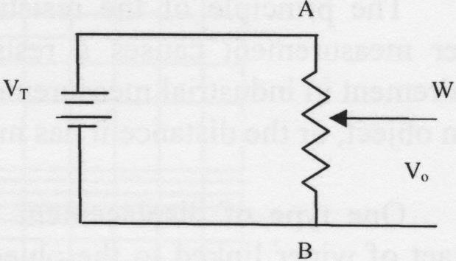
Potentiometers
R₁
R
V_{o} = ² V_{T}
R₁ + R₂
R₂

Slide 11
Strain Gauge
Pressure, Load, Displacement Measurement

Slide 12

Strain Gauge
When a metal conductor is stretched or compressed, its resistance changes.
Backing Film
ρ L
Grid
(electrical resistor)
R =
A
Translates strain to electrical resistance.
Copper-plated Solder tabs
Resistance increases
with length.

Slide 13
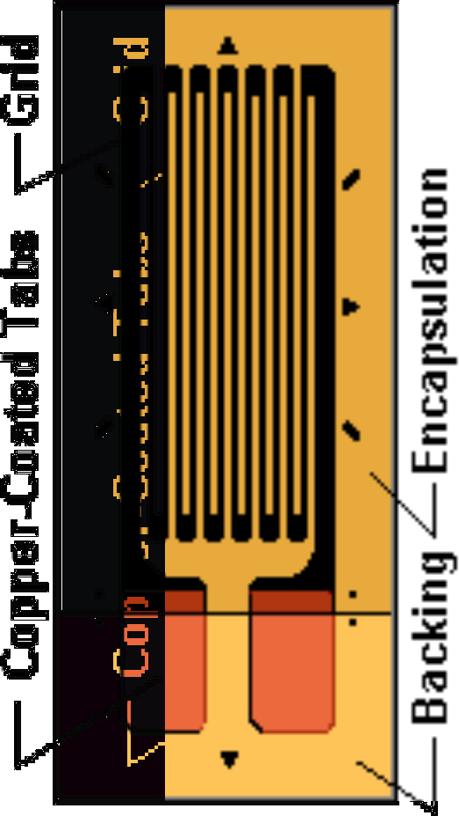

Strain Gauges
Gauge series | Gauge base materials | Operational temperature
F | Epoxy resin | -20~+80 (°C)
QF | Polyimide resin | -20~+200 (°C)
EF | Polyimide resin | -20~+200 (°C)
11

Slide 14
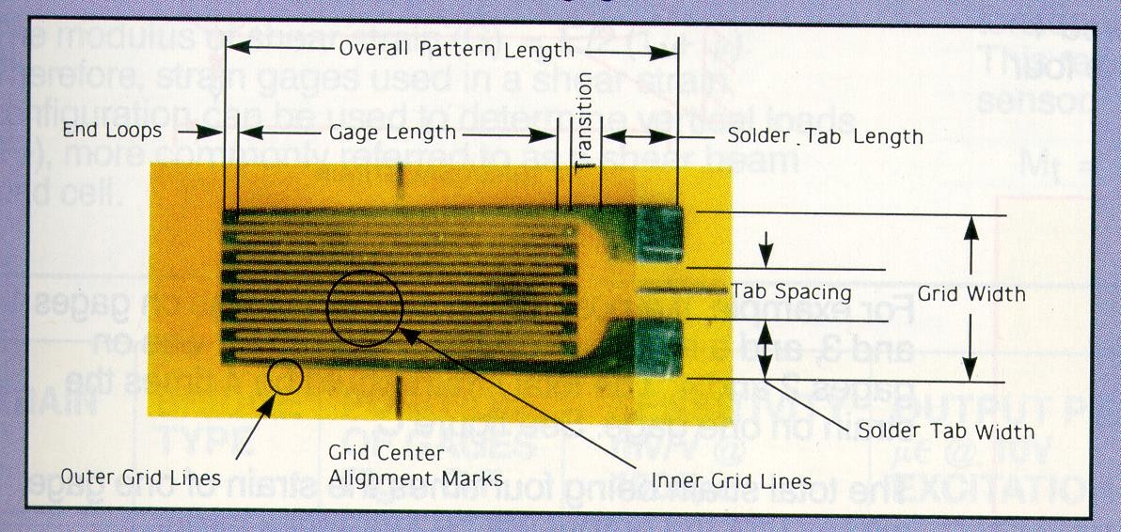
Bonded Strain Gauge
Carrier (substrate + cover)

Slide 16
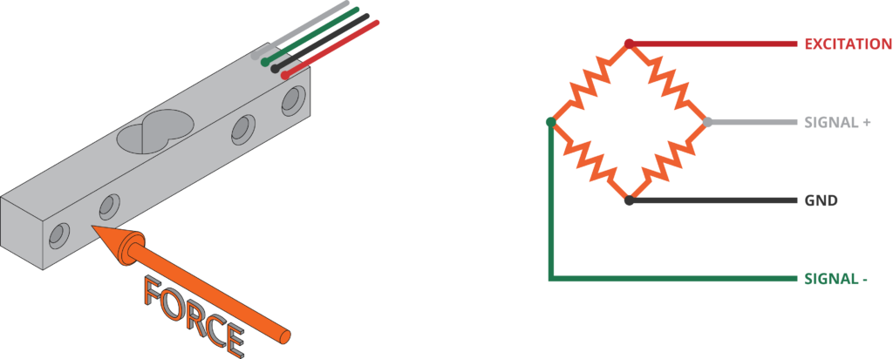
Strain gauge
https://www.monodaq.com/applications/docs/u-x/front-end/load-cells/
Electrical resistance varies with applied strain
Strain – deformation or displacement of a material due to the applied stress
Stress = Force/Area
Strain gauges convert the applied forces, pressure, torque etc., to electrical signals that can be measured.
Load cells – used to concentrate the stress towards the strain gauge

Slide 17
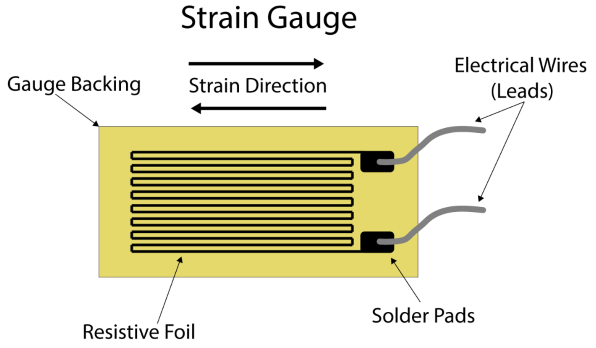
Source: https://www.michsci.com/what-is-a-strain-gauge/?cn-reloaded=1 as on 17-04-21

Slide 18
Working
Multiple strain gauges can be connected to measure small changes in electrical resistance – Wheatstone’s bridge
In WB, an excitation voltage is applied across the circuit and o/p voltage is measure between two points at the middle of the bridge.
When there is no load, the WB is balanced and there is zero output voltage
Whenever there is a force exerted, it deforms the material which causes the resistance to change and hence the output voltage changes.
A signal amplifier amplifies this small change, which in turn amplifies the noises.
A signal conditioning circuitry removes these noises

Slide 19
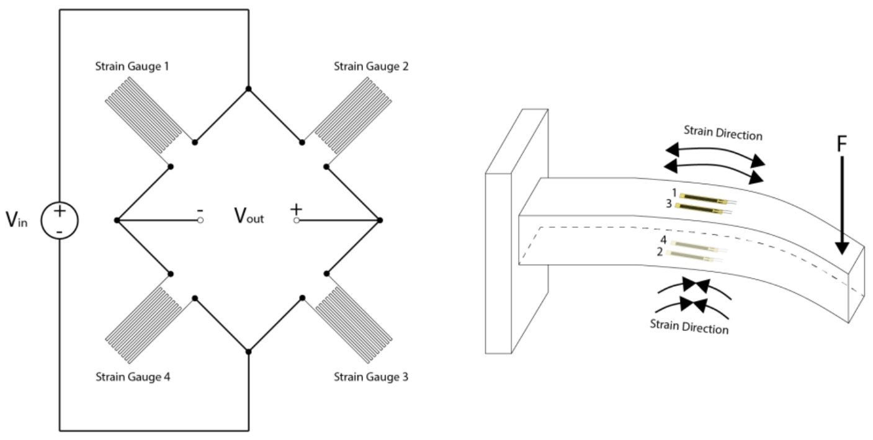
Source: https://www.michsci.com/what-is-a-strain-gauge/?cn-reloaded=1 as on 17-04-21

Slide 20
Strain Gauges
If a metal conductor is stretched or compressed, its resistance changes on account of the fact that both length and diameter of conductor change. Also there is a change in the value of resistivity of the conductor when it is strained and this property is called piezoresistive effect. Therefore, resistance strain gauges are also known as piezoresistive gauges.
The strain gauges are used for measurement of strain and associated stress in experimental stress analysis. Secondly, many other detectors and transducers, notably the load cells, torque meters, diaphragm type pressure gauges, temperature sensors, accelerometers and flow meters, employ strain gauges as secondary transducers.
11

Slide 21
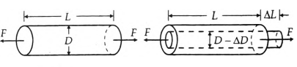
Strain Gauges
The change in the value of resistance by straining the gauge may be partly explained by the normal dimensional behaviour of elastic material. If a strip of elastic material is subjected to tension its longitudinal dimension will increase while there will be a reduction in the lateral dimension. So when a gauge is subjected to a positive strain, its length increases while its area of cross-section decreases.
Change in dimensions of a strain gauge
element when subjected to a tensile force.
11

Slide 22
Strain Gauges
Since the resistance of a conductor is proportional to its length and inversely proportional to its area of cross-section, the resistance of the gauge increases with positive strain. The change in the value resistance ofstrained conductor is more than what can be accounted for an increase in resistance due to dimensional changes. The extra change in the value of resistance is attributed to a change in the value of resistivity of a conductor when strained. This property, as described earlier, is known as peizoresistive effect.
11

Slide 23
Strain Gauges
Let us consider a strain gauge made of circular wire. The wire has the dimensions :
length = L,
area = A,
diameter = D before being strained.
The material of the wire has a resistivity p. Resistance of unstrained gauge R = ρL/ A.
Let a tensile stress s be applied to the wire. This produces a positive strain causing the length to increase and area to decrease as shown in Fig.
11

Slide 24
Strain Gauges
Thus when the wire is strained there are changes in its dimensions.
Let ΔL = change in length,
ΔA = change in area,
ΔD = change in diameter and
ΔR = change in resistance.
In order to find how ΔR depends upon the material physical quantities, the expression for R is differentiated with respect to stress s.
11

Slide 25
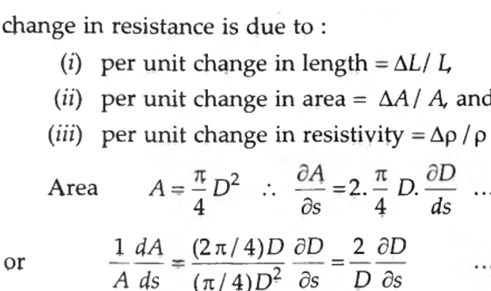
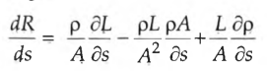
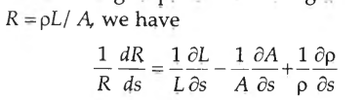
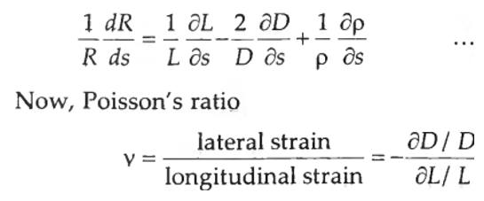
Strain Gauges
11

Slide 26
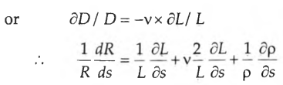
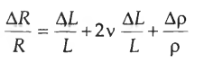
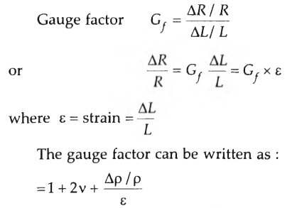
Strain Gauges
The gauge factor is defined as the ratio of per unit change in resistance to per unit change in length.

Slide 27
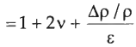
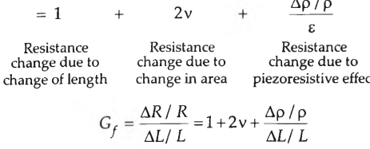
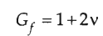
Strain Gauges
The gauge factor can be written
The strain is usually expressed in terms of microstrain. 1 microstrain = 1 μm / m.
If the change in the value of resistivity of a material when strained is neglected, the gauge factor
The Poisson's ratio for all metals is between 0 and 0.5. This gives a gauge factor of approximately, 2. The common value for Poisson's ratio for wires is 0.3. This
gives a value of 1.6 for wire wound strain gauges

Slide 28
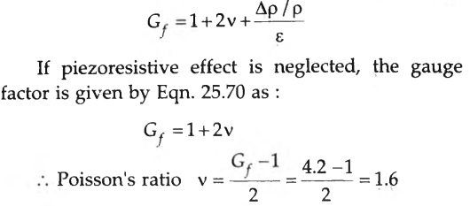
Strain Gauges
A resistance wire strain gauge uses a soft iron wire ofsmall diameter. The gauge factor is + 4.2. Neglecting the piezoresistive effects, calculate the Poisson's
ratio.

Slide 29
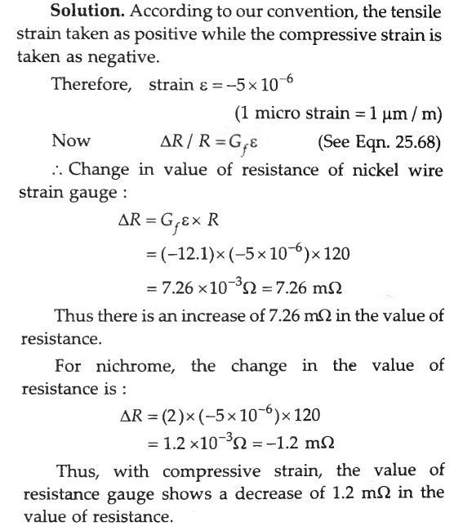
Strain Gauges
A compressive force is applied to a structural member. The strain is 5 micro-strain: Two separate strain gauges are attached to the structural member, one is a nickel wire strain gauge having a gauge factor of-12.1 and the other is nichrome wire strain gauge having a gauge factor of 2. Calculate the value of resistance ofthe gauges after they are strained. The resistance of strain gauges before being strained is 120 Ω.

Slide 30
Strain Gauges
TYPES OF STRAIN GAUGES
The following are the major types of strain gauges:
A Unbonded metal strain gauges
A Bonded metal wire strain gauges
A Bonded metal foil strain gauges
A Vacuum deposited thin metal film strain gauges
A Sputter deposited thin metal strain gauges
A Bonded semiconductor strain gauges
A Diffused metal strain gauges.
Strain gauges are broadly used for two major types of applications and they are : (i) Experimental stress analysis of machines and structures, and (ii) Construction of force, torque, pressure, flow and acceleration transducers.

Slide 31
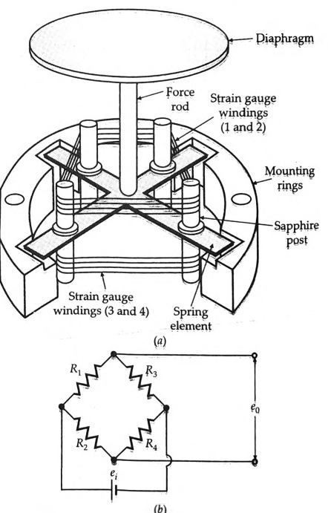
Strain Gauges
Unbonded Metal Strain Gauge
An unbonded metal strain gauge is shown in Fig. This gauge consists of a wire stretched between two points in an insulating medium such as air. The wires may be made of various copper nickel, chrome nickel or nickel iron alloys. They are about 0.003 mm in diameter, have a gauge factor of 2 to 4 and sustain 9 force of 2 mN. The length of wire is 25 mm or less.
In Fig., the flexture element is connected via a rod to a diaphragm which is used for sensing of pressure. The wires are tensioned to avoid buckling when they experience a compressive force
Set-up of a unbonded strain gauge and measurement with a Wheatstone bridge

Slide 32
Strain Gauges
The unbonded metal wire gauges, used almost exclusively in transducer applications, employ preloaded resistance wires connected in a wheatstone bridge as shown in Fig.
At initial preload, the strains and resistances of the four arms are nominally equal, with the result the output voltage of the bridge, e0 = 0.
Application of pressure produces a small displacement which is about 0.004 mm (full scale), the displacement increases tension in two wires and decreases it in the other two, thereby increase the resistance of two wires which are in tension and decreasing the resistance of the remaining two wires.
This causes an unbalance of the bridge producing an output voltage which is proportional to the input displacement and hence to the applied pressure.

Slide 33
Strain Gauges
Bonded Wire Strain Gauges
The bonded metal-wire strain gauges are used for both stress analysis and for construction of transducers. A resistance wire strain gauge consists of a grid of fine resistance wire of about 0.025 mm in diameter or less. The grid is cemented to carrier (base) which may be a thin sheet of paper, a thin sheet of bakelite or a sheet of teflon.
The wire is covered on top with a thin sheet of material so as to prevent it from any mechanical damage. The spreading of wire permits a uniform distribution of stress over the grid. The carrier is bonded with an adhesive material to the specimen under study. This permits a good transfer of strain from carrier to grid of wires.
The wires cannot buckle as they are embedded in a matrix of cement and hence faithfully follow both the tensile and compressive strains of the specimen. Since, the materials and the wire sizes used for bonded wire strain gauges are the same as used for unbonded wire strain gauges, the gauge factors and resistances for both are comparable

Slide 34
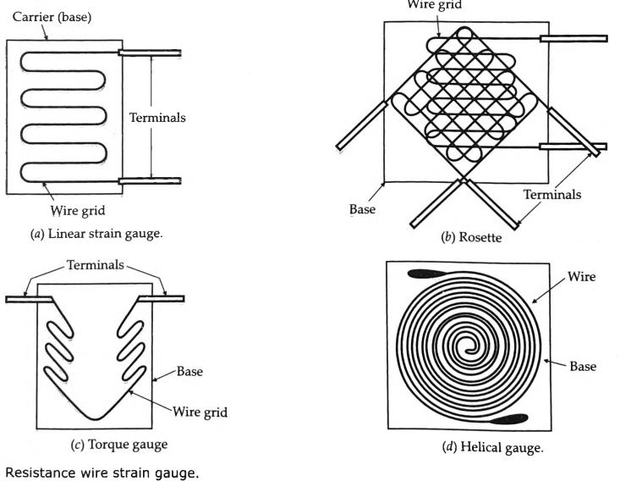
Strain Gauges

Slide 35
Strain Gauges
Desirable that the resistance wire strain gauges should have the following characteristics
The strain gauge should have a high value of gauge factor Gf. A high value of gauge factor indicates a large change in resistance for a particular strain resulting in high sensitivity.
The resistance of the strain gauge should be as high as possible since this minimizes the effects of undesirable variations of resistance in the measurement.
The strain gauges should have a low resistance temperature co-efficient. This is essential to minimise errors on account of temperature variations which affect the accuracy of measurements.
The strain gauge should not have any hysteresis effects in its response.
In order to maintain constancy of calibration over the entire range of the strain gauge, it should have linear characteristics i.e., the variations in resistance should be a linear function of the strain.
The strain gauges are frequently used for dynamic measurements and hence their frequency response should be good. The linearity should be maintained within accuracy limits over the entire frequency range

Slide 36
Strain Gauges
Base (Carrier) Materials Several types of base or carrier materials are used to support the wires. Impregnated paper is used for room temperature applications. The range of some of the other materials is : Epoxy - 200°C to 150°C, Bakelite cellulose or fibre glass materials - upto 200°C for continuous operation and 300°C for limited operation.
Adhesives The adhesives act as bonding materials. Like other bonding operations, successful strain gauge bonding depends upon careful surface preparation and use of the correct bonding agent. In order that the strain be faithfully transferred on to the strain gauge, the bond has to be formed between the surface to be strained and the plastic backing material on which the gauge is mounted. It is usually desirable that the adhesive material should be of quick drying type and also be insensitive to moisture in order to have good adherence. Ethylcellucose cement, nitrocellucose cement, bakelite cement and epoxy cement are some of the commonly used adhesive materials. The temperature range up to which they can be used is usually below 175°C.
Leads The leads should be of such materials which have low and stable resistivity and also a low resistance temperature co-efficient

Slide 37
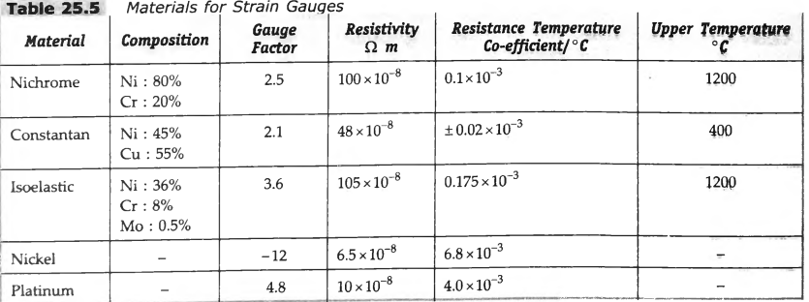
Strain Gauges

Slide 38
Strain Gauges
Bonded Metal Foil Strain Gauges
This class of strain gauges is only an extension of the bonded metal wire strain gauges. The bonded metal wire strain gauges have been completely superseded by bonded metal foil strain gauges.
Metal foil strain gauges use identical or similar materials to wire strain gauges and are used today for most general-purpose stress analysis applications and for many transducers. The metals and alloys used for foil type strain gauges are shown in Table.
A typical bonded metal foil strain gauge is shown in Foil type gauges have a much greater heat dissipation capacity as compared with wire wound strain gauges on account of their greater surface area for the same volume.
For this reason, they can be used for higher operating temperature range. Also the large surface area leads to better bonding.

Slide 39
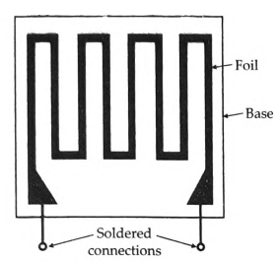
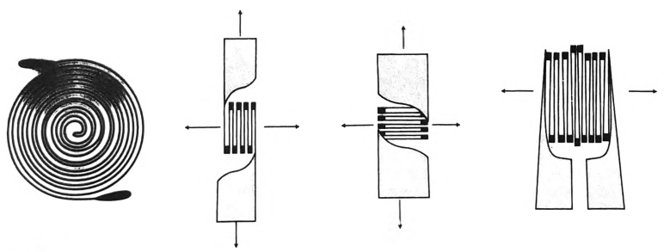
Strain Gauges
Bonded metal foil gauge
Metal foil strain gauges.

Slide 40
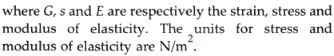
Strain Gauges
Hooke's law gives a relationship between stress and strain for linear stress-strain curve (i.e., for elastic limits) in terms of modulus of elasticity of the material under stress. Hooke's law may be written as :

Slide 41
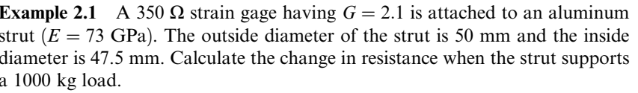
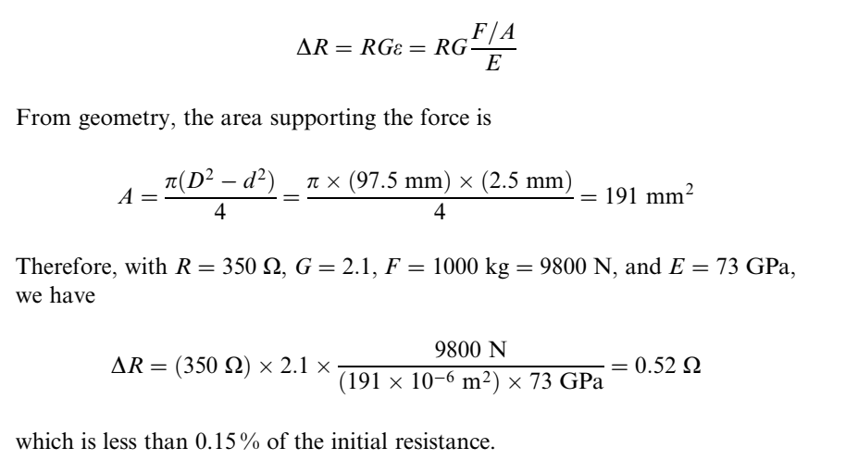
Strain Gauge

Slide 42
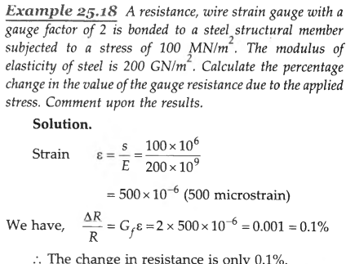
Strain Gauges

Slide 43
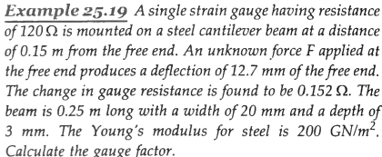
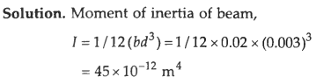
Strain Gauges

Slide 44
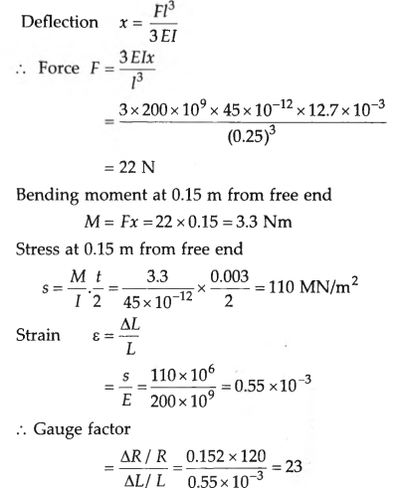
Strain Gauges

Slide 45
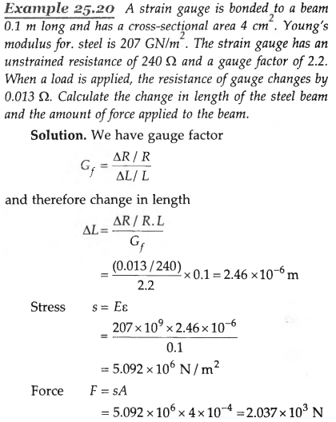
Strain Gauges

Slide 46
Strain Gauges
Semi-conductor Strain Gauges
It has been explained above in order to have a high sensitivity, a high value of gauge factor is desirable.
A high gauge factor means a relatively higher change in resistance which can be easily measured with a good degree of accuracy.
Semiconductor strain gauges are used where a very high gauge factor and a small envelope are required.
The resistance of the semi-conductors changes with change in applied strain.
Unlike in the case of metallic gauges where the change in resistance is mainly due to change in dimensions when strained, the semi-conductor strain gauge depend for their action upon piezo-resistive effect i.e., the change in the value of the resistance due to change in resistivity

Slide 47
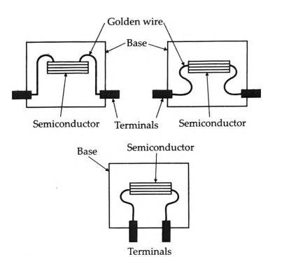
Strain Gauges
Semi-conductor Strain Gauges
Semi-conducting materials such as silicon and germanium are used as resistive materials for semi-conductor strain gauges.
A typical strain gauge consists of a strain sensitive crystal material and leads that are sandwiched in a protective matrix.
The production of these gauges employs conventional semi-conductor technology using semi-conducting wafers or filaments which have a thickness of 0.05 mm and bonding them on a suitable insulating substrates, such as teflon.
Gold leads are generally employed for making the contacts. These strain gauges can be fabricated along with integrated circuit (IC) operational amplifiers which can act as pressure sensitive transducers.

Slide 48
Strain Gauges
Advantages
(i) Semi-conductor strain gauges have the advantage that they have a high gauge factor of about ± 130. This allows measurement of very small strains of the order of 0.01 microstrain.
(ii) Hysteresis characteristics of semi-conductor strain gauges are excellent. Some units maintain it to less than 0.05%.
(iii) Fatigue life is in excess of 10 x 1M operations and the frequency response is upto 10THz.
(iv) Semi-conductor strain gauges can be very small ranging in length from 0.7 to 7 mm. They are very useful for measurement of local strains
Disadvantages
The major and serious disadvantage of semi-conductor strain gauges is that they are very sensitive to changes in temperature.
Linearity of the semi-conductor strain gauge is poor.
Semi-conductor strain gauges are more expensive and difficult to attach to the object under study.

Slide 49
Strain Gauges
Diffused Strain Gauges
The diffused strain gauges are primarily used in transducers. The diffusion process used in IC manufacture is employed.
In pressure transducers, for example, the diaphragm would be of silicon rather than metal and the strain gauge effect would be realized by depositing impurities in the diaphragm to form an intrinsic strain gauge.
This type of construction may allow lower manufacturing costs in some designs, as a large number of diaphragms can be made on a single silicon wafer.

Slide 50
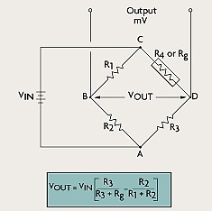
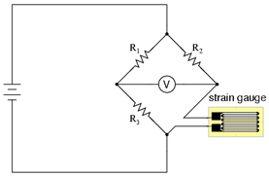
Strain Gauge used with Wheat Stone Bridge

Slide 51
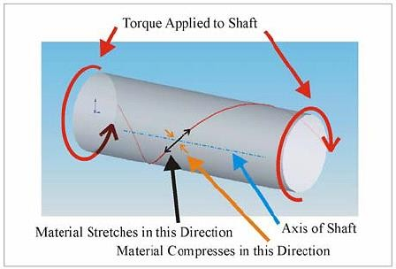
Torque Measurement

Slide 52
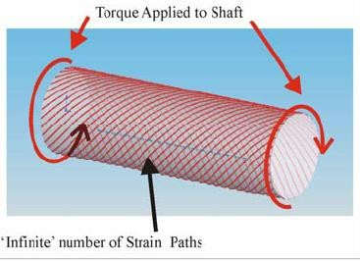
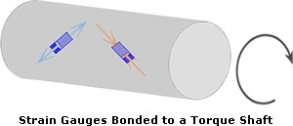
Torque Measurement
The Strain gauge can be placed on any one of these strain paths. If one end of the shaft is fixed, then it is advisable to place the strain gage near the fixed end.

Slide 53
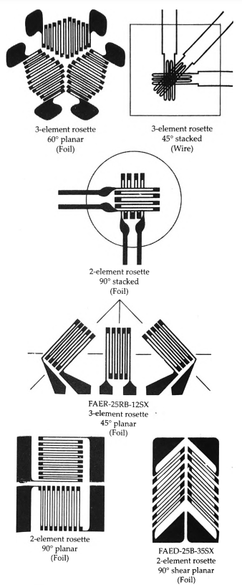
Strain Gauges
ROSETTES
In addition to single element strain gauges, a combination of strain gauges called "Rosettes" are available in many combinations for specific stress analysis or transducer applications.
In practical problems, an element may be subjected to stresses in any direction and hence it is not possible to locate the direction of principal stress.
Therefore, it is not possible to orient the strain, gauges along the direction of principal stress. Hence there The solution to the problem lies inis a necessity to evolve a strain gauge measurement system which measures the values of principal strains and stresses without actually knowing their directions. using three strain gauges to form a unit called a Rosette

Slide 54
Resistance Thermometers (RTD)

Slide 55
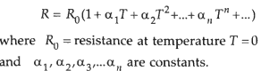
Resistance Thermometers
The resistance of a conductor changes when its temperature is changed. This property is utilized for measurement of temperature The variation of resistance R with temperature T(°K) can be represented by the following relationship for most of the metals as
Platinum is especially suited for this purpose, as it can withstand high temperatures while maintaining excellent stability. As a noble metal, it shows limited susceptibility to contamination. All metals produce a positive change in resistance with temperature. This, of course, is the main function of an RTD. The system error is minimized when the nominal value of RTD is large. This implies a metal with a high value of resistivity should be used for RTDs. The lower is the resistivity of the metal, the more material we will have to use. The requirements of a conductor material to be used in RTDs are : (i) The change in resistance of material per unit change in temperature should be as large as possible. (ii) The material should have a high value of resistivity so that minimum volume of material is used for the construction of RTD. (iii) The resistance of materials should have a continuous and stable relationship with temperature.

Slide 56
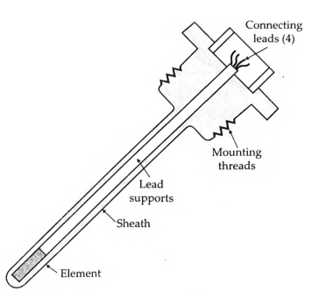
Resistance Thermometers
Gold and Silver are rarely used for construction of RTDs on account of their low resistivities.
Tungsten has relatively a high resistivity, but is reserved for high temperature applications as it is extremely brittle and difficult to work.
Copper is used occasionally as an RTD element. Its low resistivity forces the element to be longer than the platinum element, but its low linearity and low cost make it an economical alternative. Its upper limit of temperature is about 120°C
Industrial platinum resistance
thermometer

Slide 57
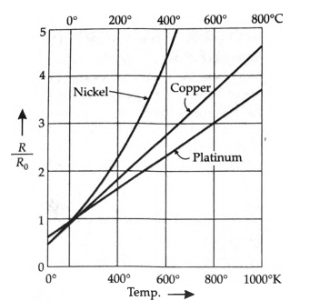
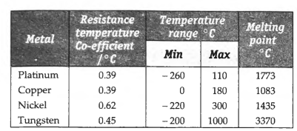
Resistance Thermometers
Metals Used for Resistance Thermometers
Characteristics of materials used for
resistance thermometers.

Slide 58
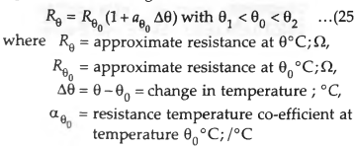
Resistance Thermometers
Linear Approximation
A linear approximation means that we may develop an equation for a straight line which approximates the resistance versus temperature curve over a specified span. Figure shows a curve of variation of resistance R with temperature 0°C. Here a straight line has been drawn between the points of the curve which represent 01°C and 02°C with 0θ°C representing the mid point temperature. The equation of this straight line is' the linear approximation of the curve from 01°C and 02°C . The equation of the straight line is written as

Slide 59
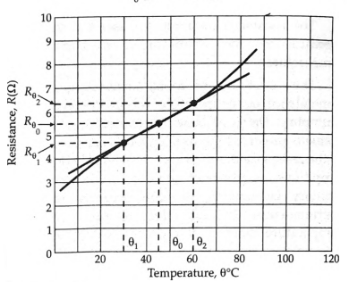
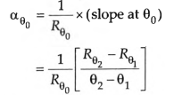
Resistance Thermometers
A straight line representing an approximate relationship between resistance R. and temperature θ

Slide 60

Resistance Thermometers

Slide 62


Resistance Thermometers
Quadratic Approximation
A quadratic approximation of the resistance temperature curve is more accurate representation of the curve over a limited range of tempera ture. The quadratic approximation relationship includes both a linear and an addition has a term which varies as the square of the difference in temperature. The approximation is written as :

Slide 63

Resistance Thermometers

Slide 64


Resistance Thermometers

Slide 66

Resistance Thermometers

Slide 67

Resistance Thermometers

Slide 68


Resistance Thermometers

Slide 69
Resistive Temperature Detectors (RTDs)

Slide 70
RESISTIVE TEMPERATURE DETECTORS (RTDs)
An RTD (resistance temperature detector) is a temperature detector based upon a variation in electric resistance. The commonest metal for this application is platinum, which is sometimes designated PRT (platinum resistance thermometer).
Figure 2.11 shows the symbol for RTDs. The straight line diagonally crossing the resistor indicates that it changes linearly. The label near that line indicates that the change is induced by the temperature and has a positive coefficient. Three- and four-wire resistors reduce measurement errors from connecting leads.
RTDs rely on the positive temperature coefficient for a conductor’s resistance. In a conductor the number of electrons available to conduct electricity does not significantly change with temperature. But when the temperature increases, the vibrations of the atoms around their equilibrium positions increase in amplitude. This results in a greater dispersion of electrons, which reduces their average speed. Hence, the resistance increases when the temperature rises.

Slide 71

RESISTIVE TEMPERATURE DETECTORS (RTDs)

Slide 72
RESISTIVE TEMPERATURE DETECTORS (RTDs)
where R0 is the resistance at the reference temperature T0. The coefficients can
be determined from resistance measurements at fixed-point temperatures:
0.01 degree C—(triple point of water), 100 degree C (boiling water), 660.323 degree C (freezing aluminum), and so on. The resistance changes because of both the change in resistivity and the change in dimensions caused by temperature.
Dynamically, an RTD behaves as a first-order low-pass system, because the resistor has a significant heat capacity (Section 1.5.2). A covered sensor—for example, for environmental protection—has a second-order low-pass overdamped response because of the additional heat capacity of the covering.
There are some restrictions on the use of for temperature measurement.

Slide 73

RESISTIVE TEMPERATURE DETECTORS (RTDs)
First, it is not possible to measure temperatures near the melting point of the conductor. Second, we must avoid any self-heating due to the measurement circuit. Otherwise, the sensor temperature would be higher than that of the surrounding medium. For a conductor in a given environment, the heat dissipation capability is given by the heat dissipation constant or heat dissipation factor (mW/K), which depends on the surrounding fluid and its velocity, because heat loss increases by convection

Slide 74



RESISTIVE TEMPERATURE DETECTORS (RTDs)

Slide 75



RESISTIVE TEMPERATURE DETECTORS (RTDs)

Slide 76


RESISTIVE TEMPERATURE DETECTORS (RTDs)

Slide 77

RESISTIVE TEMPERATURE DETECTORS (RTDs)

Slide 78
Thermistors
Temperature-dependent resistors

Slide 79
Temperature
Temperature-measure of internal energy of substance
Four common scales
Celsius (C)
Kelvin (k)
Fahrenheit (F)
Rankine (R)

Slide 80
Measurement of temperature
TEMPERATURE SENSORS CLASSIFICATION: Contact Sensing
Thermocouple (Thermoelectric)
Thermistor (Thermal Resistors)
Negative temperature coefficient device (NTC)
Positive temperature coefficient device (PTC)
Resistive Temperature Detector (RTD)
Semiconductor Temperature sensors
Liquid-in-Glass Thermometers
Bimetallic Thermometers

Slide 81
Cont..
TEMPERATURE SENSORS CLASSIFCATION: Non-Contact Sensing
Radiation Thermometers
Infrared thermal Imaging
Scanners
Spot Radiometers
Thermal Imagers
Ratio Thermometers

Slide 82
Selecting A Temperature Sensor
Three things that we need to keep in mind when selecting temperature sensor:
What is the desired temperature range, the tolerable limit to the error in measurement and the conditions under which the measurement is to be performed?
Is it possible to touch the object and if so would the sensor or the temperature of the object be likely to be seriously affected by the contact? If the answer is yes, then a non-contact temperature sensor is needed. If no, then the answer probably lies with one of the other sensor types.
If a contact sensor appears satisfactory, then questions revolve more around temperature measuring range, satisfying the conditions of use and meeting the acceptable error allowance.

Slide 83
Thermistors: THERMal resISTORS
Thermistor is a combination of the words thermal and resistor.
Thermistor was invented by Samuel Ruben in 1930
A thermistor is a type of resistor used to measure temperature changes, relying on the change in its resistance with changing temperature.
Typically have a negative temperature coefficient (NTC), Resistance decreases with increasing temperature
A PTC thermistor works a little differently. When temperature increases, the resistance increases, and when temperature decreases, resistance decreases. This type of thermistor is generally used as a fuse.
Thermistor can measure across the range of -40~150 ±0.35 °C

Slide 84



Slide 85
What are the maximum and minimum temperatures for the device?
Thermistors are ideal when measuring a single point temperature that is within 50°C.
While there are exceptions, most thermistors work best in the range between -55°C and +114°C.
Since thermistors are nonlinear, meaning the temperature to resistance values plot on a graph as a curve rather than a straight line, very high or very low temperatures do not get recorded correctly.
For example, very small changes in very high temperatures will record negligible resistance changes, which won’t translate into accurate voltage changes.

Slide 86
Where are thermistors useful?
Where temperature needs to be controlled:
Thermostat
Kettle
Oven
How are thermistors used as thermostats in incubators for premature babies?
Premature babies need to be kept warm, so the incubator contains systems to detect faults
If the temperature falls, this is sensed by a thermistor - this causes a lamp to turn on and an alarm to sound.

Slide 87
Thermistors Classification
Thermistors can be classified into two types depending on the sign of k.
If k is positive, the resistance increases with increasing temperature, and device is called a positive temperature coefficient (PTC) thermistor, some time also known as Resistance Temperature Detector (RTD)
If Platinum and nickel are used as metal in RTD. If k is negative, the resistance decreases with increasing temperature, and the device is called a negative temperature coefficient (NTC) thermistor.
Resistors that are not thermistors are designed to have the smallest possible k, so that their resistance remains almost constant over a wide temperature range.

Slide 88

NTC thermistor
A component, the resistance of which decreases with increasing temperature
Normally used in temperature measurement
PTC Thermistor
A component, the resistance of which increases with temperature increases
Used for circuit protection

Slide 89
Thermistor construction
NTC Thermistors
NTC Thermistors are made from the oxides of metals such as manganese, cobalt, nickel and copper.
The metals are oxidized through a chemical reaction, ground to a fine powder, then compressed and subject to very high heat.
Some NTC thermistors are crystallized from semiconducting material such as silicon and germanium.
PTC Thermistors
PTC Thermistors are made by introducing small quantities of semiconducting material into a polycrystalline ceramic.
When temperature reaches a critical point, the semiconducting material forms a barrier to the flow of electricity and resistance climbs very quickly.

Slide 90

PTC working principle
Resistance of these types of thermistors increases with the rise in temperature
Due to the special Resistance- Temperature-characteristic, there is no additional temperature regulation or safety device necessary while reaching high heat-power level when using the low resistance area

Slide 91
PTC Thermistor :Application
There are very few commercial applications involving PTC thermistors that are based upon the resistance -temperature characteristic.
Dramatic rise in resistance of a PTC at and above the transition temperature makes it ideal for over current protection.

Slide 92
PTC Thermistor: Industrial Applications
Time Delay Circuit:
In the time delay circuit, as the thermistor self-heats and increases its resistance, the voltage drop on the fixed resistor decreases to a minimum.
Motor Starting
In the motor start circuit, PTC has a low resistance at turn-on so that a significant amount of current is permitted to flow in the starting winding of the motor.
After the thermistor has self-heated into a high resistance state, the current through the starting winding becomes negligible.

Slide 93
NTC working principle
Resistance of NTC thermistors decreases proportionally with increases in temperature.
Each thermistor material will have a different material constant (B) and therefore a different resistance versus temperature curve.
B value will define the thermistor’s material constant between the range of T1 and T2
T1-thermistors resistive value at a first temperature or base point, (which is usually 25ºC)
T2-the thermistors resistive value at a second temperature point, for example 100ºC
B is a calibration constant depending on the thermistor material, usually between 3,000 and 5,000.

Slide 94

Thermistor
Semiconductor resistance sensors
Unlike metals, thermistors respond negatively to temperature and their coefficient of resistance is of the order of 10 times higher than that of platinum or copper.
NEGATIVE TEMPERATURE CO-EFFICIENT
Temperature semiconductor resistance
Symbol

Slide 95


Practical Thermistors
NTC => “Negative Temperatur Coefficient” => Resistance goes DOWN with increasing temperature

Slide 96
Thermistors
Thermistor is a contraction of a term "thermal resistors". Thermistors are generally composed of semi-conductor materials.
Although positive temperature co-efficient of units (which exhibit an increase in the value of resistance with increase in temperature) are available, most thermistors have a negative coefficient of temperature resistance i.e. their resistance decreases with increase of temperature.
The negative temperature coefficient of resistance can be as large as several percent per degree Celsius. This allows the thermistor circuits to detect very small changes in temperature which could not be observed with an RTD or a thermocouple.
In some cases the resistance of thermistor at room temperature may decrease as much as 5 percent for each 1°C rise in temperature. This high sensitivity to temperature changes makes thermistors extremely useful for precision temperature measurements control and compensation

Slide 97

Thermistors

Slide 98

Thermistors
Resistance-Temperature
Characteristics of Thermistors The mathematical expression for the relationship between the resistance of a thermistor and absolute temperature of thermistor is

Slide 99


Thermistors
The characteristics of thermistors are no doubt non-linear but a linear approximation of the resistance-temperature curve can be obtained over a small range of temperature. Thus, for a limited range of temperature, the resistance of a thermistor varies as given by Eqn
Resistance-temperature characteristics of a typical thermistor and platinum.

Slide 100


Thermistors
An individual thermistor curve can be closely approximated through the Steinhart-Hart equation :
A, B and C are found by selecting three data points on the published data curve and solving the three simultaneous equations. When the data points are chosen to span no more than 100°C within the nominal centre of thermistors temperature range, this equation approaches a remarkable ±0.2 °C curve fit.
where A, B and C are found by selecting three (R, T) data points and solving three resultant simultaneous equations.

Slide 101

Thermistors
Relationship that can be conveniently used for resistance-temperature curve of thermistors is
where, RT.,R0= resistance of thermistor at temperature T°K and ice point respectively.

Slide 102
Thermistors
Voltage-Current and Current-Time Characteristics of Thermistors
Voltage-Current Characteristics. These characteristics are shown Figure shows that the voltage drop across a thermistor increases with increasing current until is reaches a peak value beyond which the voltage drop decreases as the current increases.
In this portion of the curve, the thermistor exhibits a negative resistance characteristic.
If a very small voltage is applied to the thermistor, the resulting small current does not produce sufficient heat to raise the temperature of the thermistor above ambient.
Under this condition, Ohm's law is followed and the current is proportional to the applied voltage. Larger currents, at larger applied voltages, produce enough heat to raise the thermistor temperature above the ambient temperature and its resistance then decreases. As a result, more current is then drawn and the resistance decreases further. The current continues to increase until the heat dissipation of the thermistor equals the power supplied to it. Therefore, under any fixed ambient conditions, the resistance of a thermistor is largely a function of the power being dissipated within itself, provided that there is enough power available to raise its temperature above ambient. Under such operating conditions, the temperature of the thermistor may rise 100°C or 200°C and its resistance may drop to one-thousandth of its value at low current.

Slide 103

Thermistors
Voltage-Current and Current-Time Characteristics of Thermistors

Slide 104

Thermistors
Current Time Characteristics. The current-time characteristics shown in Fig. indicate the time delay to reach, maximum current as a function of the applied voltage. When the heating effect just described occurs in a thermistor network, a certain finite time is required for the thermistor to heat and the current to build up to a maximum steady-state value. This time, although fixed for a given set of circuit parameters, may easily be varied by changing the applied voltage or the series resistance of the circuit. This time-current effect provides a simple and accurate means of achieving time delays from milliseconds to many minutes.

Slide 105
Thermistors
The other applications of thermistors include :
(i) measurement of power at high frequencies
(ii) measurement of thermal conductivity
(iii) measurement of level flow and pressure of liquids
(iv) measurement of composition of gases
(v) vacuum measurements and
(vi) providing time delay.

Slide 106
Thermistors
Salient Features of Thermistors
Thermistors are compact, rugged and inexpensive.
Thermistors when properly aged, have good stability.
The response time of thermistors can vary from a fraction of a second to minutes, depending on the size of the detecting mass and thermal capacity of the thermistor. It varies inversely with the dissipation factor. The power dissipation factor varies with the degree of thermal isolation of the thermistor element.
The upper operating limit of temperature for thermistors is dependent on physical changes in the material or solder used in attaching the electrical connections and is usually 400°C or less. The lower temperature limit of temperature is normally determined by the resistance reaching such a high value that it cannot be measured by standard methods.
The measuring current should be maintained to as low a value as possible so that self heating of thermistors is avoided otherwise errors are introduced on account of change of resistance caused by self heating. The average power dissipation can be effectively reduced and the highest sensitivity retained by energizing the thermistor with pulses of measuring power
Thermistors can be installed at a distance from their associated measuring circuits if elements of high resistance are used such that the resistance of leads (even though the leads may be very long) is negligible. This way the resistance of leads does not affect the readings and hence errors on this count are negligible.

Slide 107

Thermistors

Slide 108

Thermistors

Slide 109

Thermistors

Slide 110

Resistance - Temperature Relation in
The Steinhart–Hart equation is a model of the resistance of a semiconductor at different temperatures. The equation is:
Thermistor
A , B and C are the Steinhart–Hart coefficients which vary depending on the type and model of thermistor and the temperature range of interest.

Slide 111


Resistance - Temperature Relation in Thermistor
R₀ = Resistance at reference temperature,
R_{T} = Resistance at measured temperature,
β = Constant dependent on thermistor

Slide 112
Measurement of temperature
TEMPERATURE SENSORS CLASSIFICATION: Contact Sensing
Thermocouple (Thermoelectric)
Thermistor (Thermal Resistors)
Negative temperature coefficient device (NTC)
Positive temperature coefficient device (PTC)
Resistive Temperature Detector (RTD)
Semiconductor Temperature sensors
Liquid-in-Glass Thermometers
Bimetallic Thermometers

Slide 113



Thermistor

Slide 114

Resistance - Temperature Relation in Thermistor
B can be calculated from the NTC thermistor resistance at two reference temperatures T1 and T2. If the measured resistances are, respectively, R1 and R2, successively replacing these values in the equation and solving for B yields

Slide 115

Resistance - Temperature Relation in Thermistor

Slide 116


Thermistor

Slide 117


Thermistor

Slide 118




Thermistor

Slide 119


Thermistor
the maximal voltage

Slide 120





Thermistor

Slide 121



Thermistor

Slide 122

Scan example 6.3 module page 109
Govardhan
24

Slide 123
Thermistor Advantages
High resistance (1 kΩ to 100 kΩ)
Eliminates problems with resistance in lead wires
Can be linearized
Small physical size
Fast response time
Not as small as thermocouples
Lower cost than RTDs
Easy to manufacture in bulk
Very high sensitivity and resolution
Up to 1000 times more sensitive than RTDs
Can withstand shock and vibration

Slide 124
Thermistor Disadvantages
Limited temperature range, typically -100 ~ 150 °C (-148 ~ 302 °F).
Errors can result from self excitation currents being dissipated by the thermistors.
They get de-calibrated on exposure to higher temperatures
The nonlinear response requires extra circuitry
Limited range of linear response with this additional circuitry
Narrow “linear” operating range for a single sensor
The glass can break if mishandled
Requires an excitation current
High resistance leads to self-heating errors (more so than RTDs)
Less stable than RTDs

Slide 125
Variable Inductance Transducers

Slide 126
Variable Inductance Transducers
The variable inductance transducers work, generally, upon one of the following three principles:
change of self inductance,
change of mutual inductance, and
production of eddy currents,

Slide 127
Self and Mutual Inductance
What is Inductance?
Inductance is the tendency of an electrical conductor to oppose a change in the electric current flowing through it. L is used to represent the inductance, and Henry is the SI unit of inductance. 1 Henry is defined as the amount of inductance required to produce an emf of 1 volt in a conductor when the current change in the conductor is at the rate of 1 Ampere per second.
An electric current flowing through a conductor creates a magnetic field around it. The strength of the field depends upon the magnitude of the current. The generated magnetic field follows any changes in the current, and from Faraday’s law of induction, we know that changing the magnetic field induces an electromotive force in the conductor. Considering this principle, inductance is defined as the ratio of the induced voltage to the rate of change of current causing it. The electronic component designed to add inductance to a circuit is an inductor.

Slide 128
Self and Mutual Inductance
Factors Affecting Inductance
Following factors affect the inductance in a circuit:
Number of Wire Turns in the Coil Inductance is greater when the number of turns of wire in the coil is greater. More coils of wires indicate a greater amount of magnetic field force for a given amount of coil current.
Coil Area Inductance is proportional to the coil area. Greater the coil area, the greater the inductance. Greater coil area presents less opposition to the formation of magnetic field flux for a given amount of field force
Core Material The greater the magnetic permeability of the core to which the coil is wrapped around, the greater the inductance.
Coil Length The longer the coil’s length, the lesser the inductance. The shorter the coil’s length, the greater the inductance.
Types of Inductance
Inductance is classified into two types as:
Self Inductance
Mutual Inductance

Slide 129
Self and Mutual Inductance
What is Self Inductance?
When there is a change in the current or magnetic flux of the coil, an electromotive force is induced. This phenomenon is termed Self Inductance. When the current starts flowing through the coil at any instant, it is found that, that the magnetic flux becomes directly proportional to the current passing through the circuit. The relation is given as: `
𝜙=𝐿×𝐼
Where L is termed as the self-inductance of the coil or the coefficient of self-inductance, the self-inductance depends on the cross-sectional area, the permeability of the material, and the number of turns in the coil.
The rate of change of magnetic flux in the coil is given as,
𝑒=–𝑑𝜙𝑑𝑡=–𝑑(𝐿𝐼)𝑑𝑡
𝑒=–𝐿𝑑𝐼𝑑𝑡

Slide 130
Self and Mutual Inductance
Self Inductance Formula
𝐿=𝑁𝜙𝐼
Where,
L is the self inductance in Henries
N is the number of turns
Φ is the magnetic flux
I is the current in amperes

Slide 131
Self and Mutual Inductance
Transducers working on principle of change of Self Inductance
The self inductance of a coil L = N² / R
where N = number of turns, and R -reluctance of the magnetic circuit.
The reluctance of the magnetic circuit R = l / µA .
Inductance L = N²µ (A/ l) = N ² µ G
where µ = effective permeability of the medium in and around the coil; H/m
G = (A/ l) = geometric form factor
A = area of cross-section of coil; m ² and / = length of coil; m
the variation in inductance may be caused by :
change in number of turns, N,
change in geometric configurations, G, and
change in permeability, µ.

Slide 132
Self and Mutual Inductance
Differential Output.
Normally the change in self inductance ΔLis adequate for detection for subsequent stages of instrumentation system. However, if the succeeding instrumentation responds to ΔL, rather than to L+ΔL the sensitivity and accuracy will be much higher. The transducer can be designed to provide two outputs one of which is an increase of self inductance and the other is a decrease in self inductance. The succeeding stages of instrumentation system measure the difference between these outputs i.e. 2 ΔL This is known as the differential output
The advantages of differential outputs are :
The sensitivity and accuracy are increased.
The output is less affected by external magnetic fields
The effective variations due to temperature changes are reduced.
The effects of changes in supply voltage and frequency are reduced.
In response to a physical signal, which is normally a displacement, the inductance of one part increases from L to L+ ΔL while that of the other part decreases from L to L- ΔL The change is measured as the difference of the two resulting in an output of 2ΔL instead ΔL when only a single winding is used.

Slide 133
Self and Mutual Inductance
What is Mutual Inductance?
Consider two coils: P – coil (Primary coil) and S – coil (Secondary coil). A battery and a key are connected to the P-coil, whereas a galvanometer is connected across the S-coil. When there is a change in the current or magnetic flux linked with the two coils, an opposing electromotive force is produced across each coil, and this phenomenon is termed Mutual Inductance.
This phenomenon is given by the relation:
𝜙=𝑀𝐼
Where M is termed as the mutual inductance of the two coils or the coefficient of the mutual inductance of the two coils.
The rate of change of magnetic flux in the coil is given as,
𝑒=–𝑑𝜙𝑑𝑡=–𝑑(𝑀𝐼)𝑑𝑡

Slide 134
Self and Mutual Inductance
Mutual Inductance Formula
𝑀=𝜇0𝜇𝑟𝑁1𝑁2𝐴𝑙
Where,
μ₀ is the permeability of free space
μ_{r} is the relative permeability of the soft iron core
N is the number of turns in coil
A is the cross-sectional area in m²
l is the length of the coil in m

Slide 135
Self and Mutual Inductance
Transducers working on principle of change of Mutual Inductance An inductive transducer working on the principle variation of mutual inductance uses multiple coils. The mutual inductance between two coils is
where L1 and L2, = self-inductances of two coils, and K = co-efficient of coupling.
Thus mutual inductance between the coils can be varied by variation of self-inductances or the co-efficient of coupling. However, the mutual inductance can be converted into a self-inductance by connecting the coils in series. The self-inductance of such an arrangement varies between
with one of the coils being stationary while the other is movable. The self-inductance of each coil is constant but the mutual inductance changes depending upon the displacement of the movable coil.

Slide 136

Self and Mutual Inductance

Slide 137
Self and Mutual Inductance
Transducers working on principle of production of Eddy Currents
These inductive transducers work on the principle that if a conducting plate is placed near a coil carrying alternating current, eddy currents are, produced in the conducting plate.
The conducting plate acts as a short-circuited secondary winding of a transformer.
The eddy currents flowing in the plate produce a magnetic field of their own which acts against the magnetic field produced by the coil.
This results in reduction of flux and thus the inductance of the coil is reduced. The nearer is the plate to the coil, the higher are the eddy currents and thus higher is the reduction in the inductance of the coil.
Thus the inductance of the coil alters with variation of distance between the plate and the coil

Slide 138

Self and Mutual Inductance
Transducers working on principle of production of Eddy Currents
If the short-circuited sleeve is away from the coil, the inductance of the coil is high while if the sleeve is covering the coil, its inductance is low. The change in inductance is a measure of displacement

Slide 139
Self and Mutual Inductance
Difference between Self and Mutual Inductance
Self inductance | Mutual inductance
In self inductance, the change in the strength of current in the coil is opposed by the coil itself by inducing an e.m.f. | In mutual inductance out of the two coils one coil opposes change in the strength of the current flowing in the other coil.
The induced current opposes the growth of current in the coil when the main current in the coil increases. | The induced current developed in the neighboring coil opposes the growth of current in the coil when the main current in the coil increases.
The induced current opposes the decay of current in the coil when the main current in the coil decreases. | The induced current developed in the neighboring coil opposes the decay of the current in the coil when the main current in the coil decreases.

Slide 140
Self and Mutual Inductance
Derivation of Inductance
Consider a DC source. When the switch is turned on, the current flows from zero to a certain value such that there is a change in the rate of current flowing. Let φ be the change in flux due to current flow. The change in flux is with respect to time which is given as:
𝑑𝜑𝑑𝑡
Apply Faraday’s law of electromagnetic induction,
𝐸=𝑁𝑑𝜙/𝑑𝑡
Where,
N is the number of turns in the coil
E is the induced EMF across the coil
From Lenz’s law, we can write the above equation as
𝐸=−𝑁𝑑𝜙/𝑑𝑡
The above equation is modified for calculating the value of inductance
𝐸=−𝑁𝑑𝜙/𝑑𝑡
𝐸=−𝐿𝑑𝑖/𝑑𝑡

Slide 141
Self and Mutual Inductance
Derivation of Inductance
N = dΦ = L dI
NΦ = Li
Therefore,
LI = NΦ = NBA
Where B is the flux density, A is the area of the coil.
Hl = NI
Where H is the magnetizing force due to magnetic flux
B = μH
L = μN²A/l = μN²𝜋r²/l
Where,
r is the radius of the coil

Slide 142
Self and Mutual Inductance
Consider a solenoid with 500 turns which are wound on an iron core whose relative permeability is 800. 40 cm is the length of the solenoid, while 3 cm is the radius. The change in current is from 0 to 3 A. Calculate the average emf induced for this change in the current for a time of 0.4 seconds.

Slide 143
Self and Mutual Inductance
Given:
No.of turns, N = 500 turns
Relative permeability, μ_{r} = 800
Length, l = 40 cm = 0.4 m
Radius, r = 3 cm = 0.03 m
Change in current, di = 3 – 0 = 3 A
Change in time, dt = 0.4 sec
Self-inductance is given as
L = μN²Al = μ₀μ_{r}N²𝜋r²/l
Substituting the values we get
(4)(3.14)(10⁻⁷)(800)(500²)(3.14)(3×10⁻²)²/0.4
L = 1.77 H
Magnitude of induced emf, ε = L di/dt = 1.77×3/0.4
ε = 13.275 V

Slide 144
Self and Mutual Inductance
There are two coils such that the current flowing through the first coil experiences a change in current flow from 2 A to 10 A in 0.4 sec. Calculate mutual inductance between the two coils when 60 mV emf is induced in the second coil. Determine the induced emf in the second coil if the current changes from 4 A to 16 A in 0.03 sec in the first coil.

Slide 145
Self and Mutual Inductance
Given:
Case 1:
Change in current, di = 10 -2 = 8 A
Change in time, dt = 0.4 sec
Magnitude of induced emf, ε₂ = 60×10⁻³ V
Case 2:
Change in current, di = 16 – 4 = 12 A
Change in time, dt = 0.03 sec
Mutual inductance of the second coil with respect to the first coil is given as:
M₂₁ = ε₂/(di/dt) = 60×10⁻³×0.4/8 = 3×10⁻³H
Induced emf in the second coil due to change in the rate of current in the first coil is given as:
ε₂ = M₂₁ di/dt = 3×10⁻³×12/0.03 = 1.2V

Slide 146

Self and Mutual Inductance

Slide 147

Self and Mutual Inductance

Slide 148
Light Dependent Resistor
The LDR
25

Slide 149


LDR
This is a resistor whose resistance depends on the amount of light falling on it.
149

Slide 150
LDR
A Light Dependent Resistor (LDR) or a photo resistor is a device whose resistivity is a function of the incident electromagnetic radiation. Hence, they are light sensitive devices. They are also called as photo conductors, photo conductive cells or simply photocells. They are made up of semiconductor materials having high resistance. There are many different symbols used to indicate a LDR, one of the most commonly used symbol is shown in the figure below. The arrow indicates light falling on it.
150

Slide 151
LDR
Working Principle of LDR
A light dependent resistor works on the principle of photo conductivity. Photo conductivity is an optical phenomenon in which the materials conductivity is increased when light is absorbed by the material.
When light falls i.e. when the photons fall on the device, the electrons in the valence band of the semiconductor material are excited to the conduction band. These photons in the incident light should have energy greater than the band gap of the semiconductor material to make the electrons jump from the valence band to the conduction band. Hence when light having enough energy strikes on the device, more and more electrons are excited to the conduction band which results in large number of charge carriers. The result of this process is more and more current starts flowing through the device when the circuit is closed and hence it is said that the resistance of the device has been decreased. This is the most common working principle of LDR
151

Slide 152


LDR
Working Principle of LDR
152

Slide 153

LDR
When light falls on an LDR its resistance falls rapidly.
In low light or the dark – they act as high resistors.
In bright light they offer very little resistance
LDRs are made from semiconductor materials to enable them to have their light sensitive properties. Many materials can be used, but one popular material for these photoresistors is cadmium sulphide, CdS.
Resistance of an LDR
153

Slide 154

LDR
154

Slide 155
Types of photoresistor
Light dependent resistors, LDRs or photoresistors fall into one of two types or categories:
Intrinsic photoresistors: Intrinsic photoresistors use un-doped semiconductor materials including silicon or germanium. Photons fall on the LDR excite electrons moving them from the valence band to the conduction band. As a result, these electrons are free to conduct electricity. The more light that falls on the device, the more electrons are liberated and the greater the level of conductivity, and this results in a lower level of resistance.
Extrinsic photoresistors:
Extrinsic photoresistors are
manufactured from semiconductor of materials doped with impurities. These impurities or dopants create a new energy band above the existing valence band. As a result, electrons need less energy to transfer to the conduction band because of the smaller energy gap.
Regardless of the type of light dependent resistor or photoresistor, both types exhibit an increase in conductivity or fall in resistance with increasing levels of incident light.
28

Slide 156
Construction of a Photocell
The structure of a light dependent resistor consists of a light sensitive material which is deposited on an insulating substrate such as ceramic. The material is deposited in zigzag pattern in order to obtain the desired resistance and power rating. This zigzag area separates the metal deposited areas into two regions. Then the ohmic contacts are made on the either sides of the area. The resistances of these contacts should be as less as possible to make sure that the resistance mainly changes due to the effect of light only.
Materials normally used are cadmium sulphide, cadmium selenide, indium antimonide and cadmium sulphonide.

Slide 157
Applications of LDR
1. Light sensors,
2. Camera light meter,
3. Street lamps, Alarm clock,
4. Burglar alarm circuits,
5. Light intensity meters,
6. Counting the packages moving on a conveyor belt.

Slide 158

LDR
LDR’s can be used to switch on street lights when light falls.
29

Slide 159


LVDT

Slide 160
L V D T
What is an LVDT?
An LVDT is a Linear Position Sensor with a Proportional Analog Output
An LVDT has 2 Elements, a Moving Core and a Stationary Coil Assembly

Slide 161
L V D Ts
What Do the Letters LVDT Stand For?

Slide 162
L V D Ts
Linear Variable Differential Transformer
Linear: Measures Linear Position
Variable: Movable Core, Fixed Coil
Differential: Natural Null Point in Middle
Transformer: AC Input / AC Output
Also called as Linear Variable Displacement Transducer

Slide 163
L V D Ts
LVDT linear position sensors are readily available that can measure movements as small as a fraction of mm (few micrometers) up to ± 100 cm.
The letters LVDT are an acronym for Linear Varible Differential Transformer, a common type of electromechanical transducer that can convert the rectilinear motion of an object to which it is mechanically coupled into a corresponding analog electrical signal.

Slide 164


Slide 165

Cross Sectional View of LVDT

Slide 166

What Is An LVDT?
The transformer's internal structure consists of a primary winding centered between a pair of identically wound secondary windings, symmetrically spaced about the primary. This coil assembly is usually the stationary element of the position sensor.
The moving element of the an LVDT is a separate tubular armature of magnetically permeable material called the core, which is free to move axially within the coil's hollow bore, and mechanically coupled to the object whose position is being measured.

Slide 167


Slide 168

Cross Sectional View of LVDT

Slide 169


Slide 170


Slide 171


Slide 172


Working of LVDT

Slide 173

How Does An LVDT Work?
This figure illustrates what happens when the LVDT's core is in different axial positions. The LVDT's primary winding, P, is energized by an AC source of constant amplitude. The magnetic flux thus developed is coupled by the core to the adjacent secondary windings, S1 and S2. If the core is located midway between S1 and S2, equal flux is coupled to each secondary so the voltages, E1 and E2, induced in each winding are equal. At this midway core position, referred to as the null point, the differential voltage output, (E1 - E2), is zero.

Slide 174


Slide 175


WORKING OF DC LVDT

Slide 176

Working of LVDT

Slide 177


Slide 178

How Does An LVDT Work?
This diagram also shows how the magnitude of the differential output voltage, E_{out}, varies with core position. The value of E_{out} at maximum core displacement from null depends upon the amplitude of the primary excitation voltage and the sensitivity factor of the particular LVDT, but is typically several Volts AC rms.

Slide 179

How Does An LVDT Work?
This 180 degree phase shift can be used to determine the direction of the core from the null point by means of appropriate circuitry. As this diagram shows, the polarity of the output signal represents the core's positional relationship to the null point.

Slide 180
AC in / AC out
ADVANTAGES
Flexible in Applications- Span and Zero Adjustable, etc.
Many Ranges and Sizes to Choose
More Robust to Environments
LIMITATIONS
Requires External Support Electronics
Requires Extra Connections to LVDT
Potential Electrical Noise Susceptibility
Potential Problems with Long Cables

Slide 181
Characteristics of LVDT
Friction-Free Operation
good Resolution
better Mechanical Life
Over travel Damage Resistant
Separable Coil And Core
Environmentally Robust
Null Point Repeatability
Fast Dynamic Response
Absolute Output

Slide 182


Slide 183


Slide 184

LVDT Support Electronics
Although an LVDT is an electrical transformer, it requires AC power of an amplitude and frequency quite different from ordinary power lines to operate properly, typically 3 V AC rms at 3 kHz. Supplying this excitation power for an LVDT is one of several functions of the LVDT support electronics, which is also known as LVDT signal conditioning equipment.

Slide 185


Slide 186


Slide 187

APPLICATIONS OF LVDT
Liquid Level Measurement using LVDT

Slide 188

Pressure Measurement using LVDT

Slide 189

Acceleration Measurement using LVDT

Slide 190

High Resolution Plant Growth Measurement based on LVDT

Slide 191

Applications of LVDT

Slide 192

LVDT

Slide 193

LVDT

Slide 194

LVDT

Slide 195

LVDT

Slide 196

LVDT

Slide 197
Capacitive transducer

